Slide 1
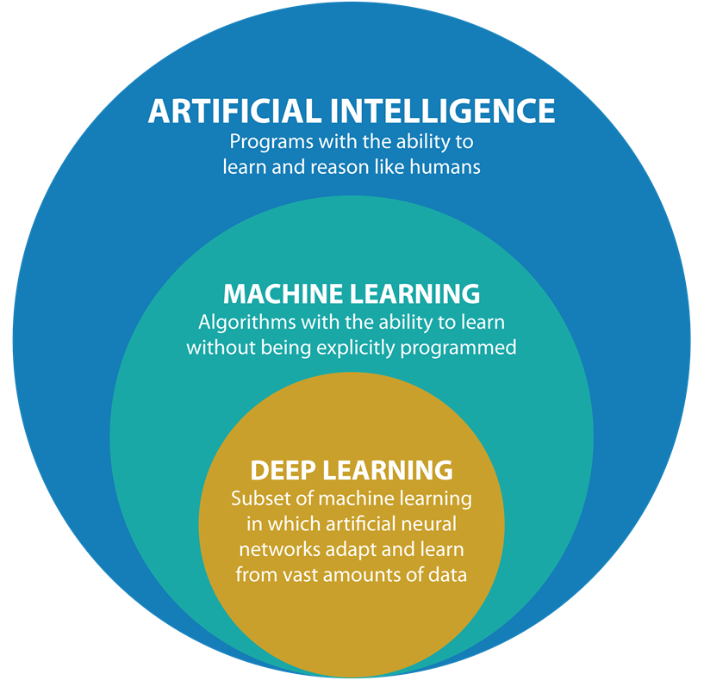
Open Lab 6: Deep Learning and Neural Networks

Slide 2
Machine Learning and Deep Learning Series
Open Lab 1: Introduction to Machine Learning and Deep Learning
Open Lab 2: Supervised Learning – Classification
Open Lab 3: Supervised Learning – Regression
Open Lab 4: Unsupervised Learning
Open Lab 5: Advanced ML – Ensemble Learning and Optimization
Open Lab 6: Deep Learning and Neural Networks
Open Lab 7: Transformer-based Models

Slide 3
Deep Learning in Everyday Life
Computer Vision
Image Classification
Object Detection
Image Segmentation
Image Generation
Natural Language Processing (NLP)
Machine Translation
Chatbots & Virtual Assistants
Speech & Audio Processing
Speech Recognition
Music Generation & Sound Synthesis
Autonomous Vehicles & Robotics
Self-Driving Cars
Drones & Delivery Bots
Industrial Automation
Generative AI
All genAI models(e.g. GPT, BERT etc. )

Slide 4
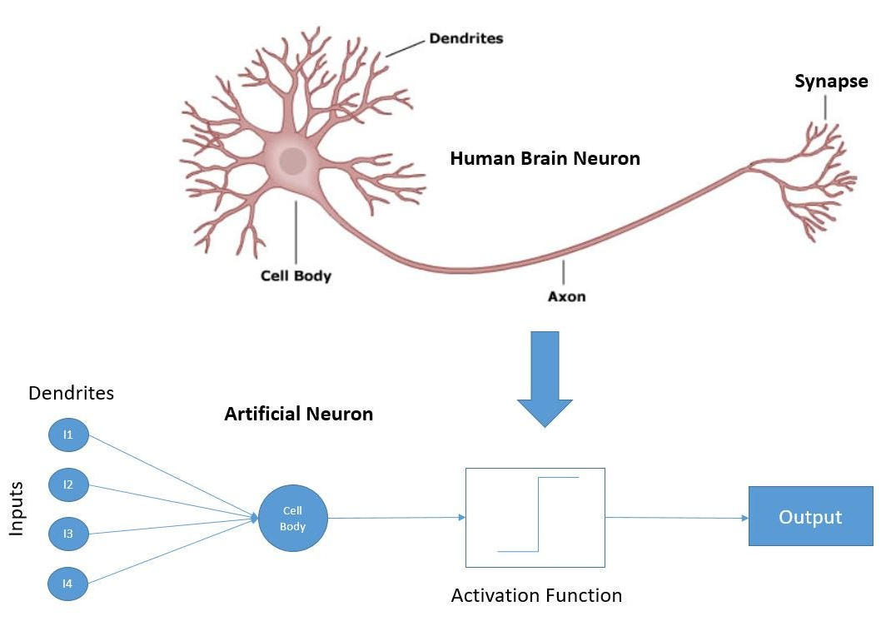
Neural Networks Inspiration

Slide 5
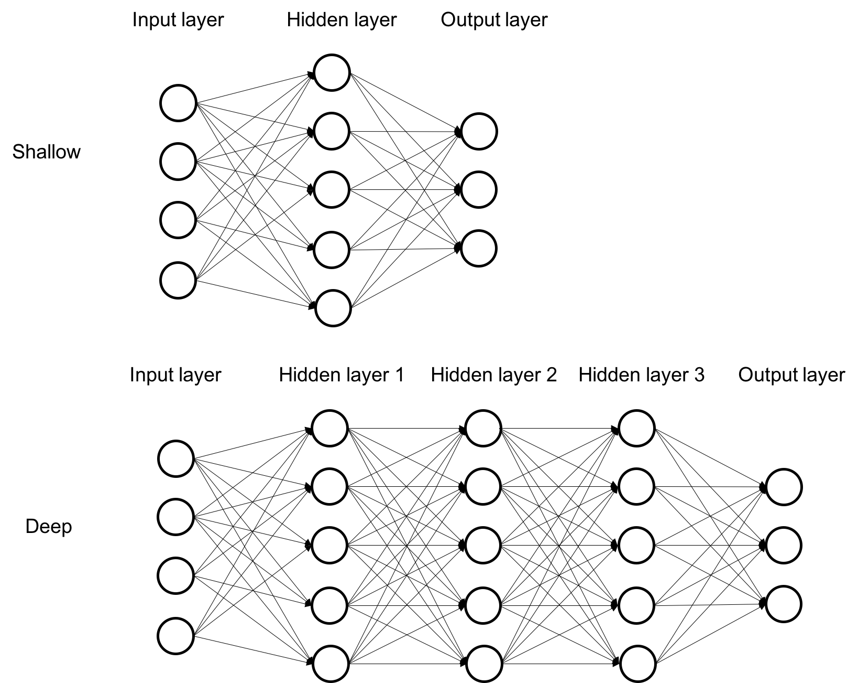
Neural Networks: Deep Learning vs Shallow Learning

Slide 6

Components of Neural Networks
Neurons
Input, Hidden, Output
Layers
Input, Hidden, Output
Weights and Biases
Functions
Activation Functions
Cost Functions
Optimization Functions
Weight Initialization

Slide 7
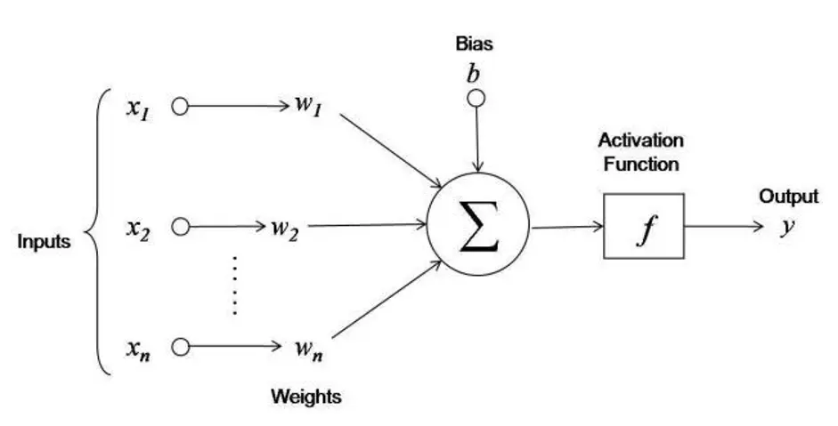
Activation Functions: Whether Neuron should be Activated(Fired)

Slide 8
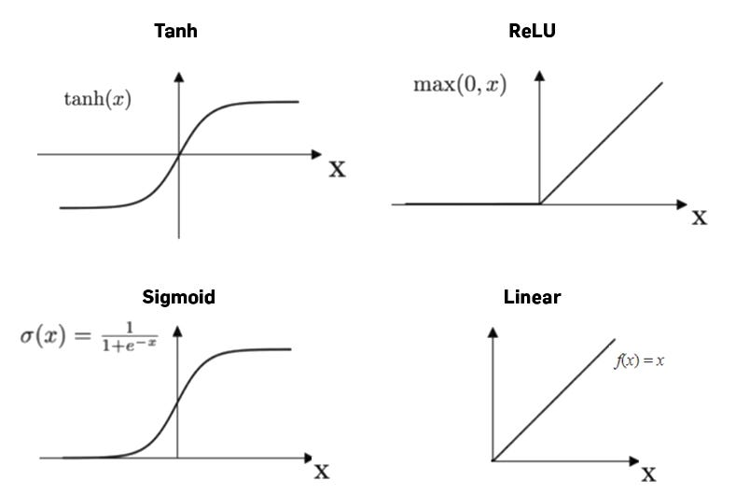
Activation Functions in Neural Networks

Slide 9
Cost Functions
Regression
Mean Squared Error (MSE)
Mean Absolute Error (MAE)
Classification
Binary Cross-Entropy
Categorical Cross-Entropy

Slide 10
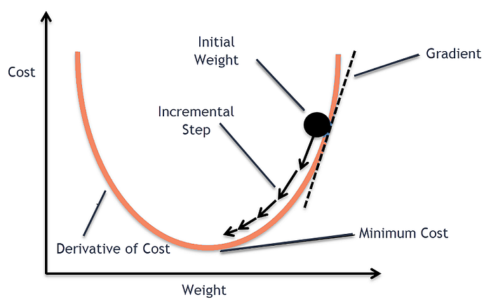
Optimization Functions: Find Optimal Parameters
Gradient Descent (GD) - slow
Stochastic Gradient Descent (SGD) -fast
Mini-Batch Gradient Descent – medium
Momentum - fast
Adam (Adaptive Moment Estimation) – fastest

Slide 11
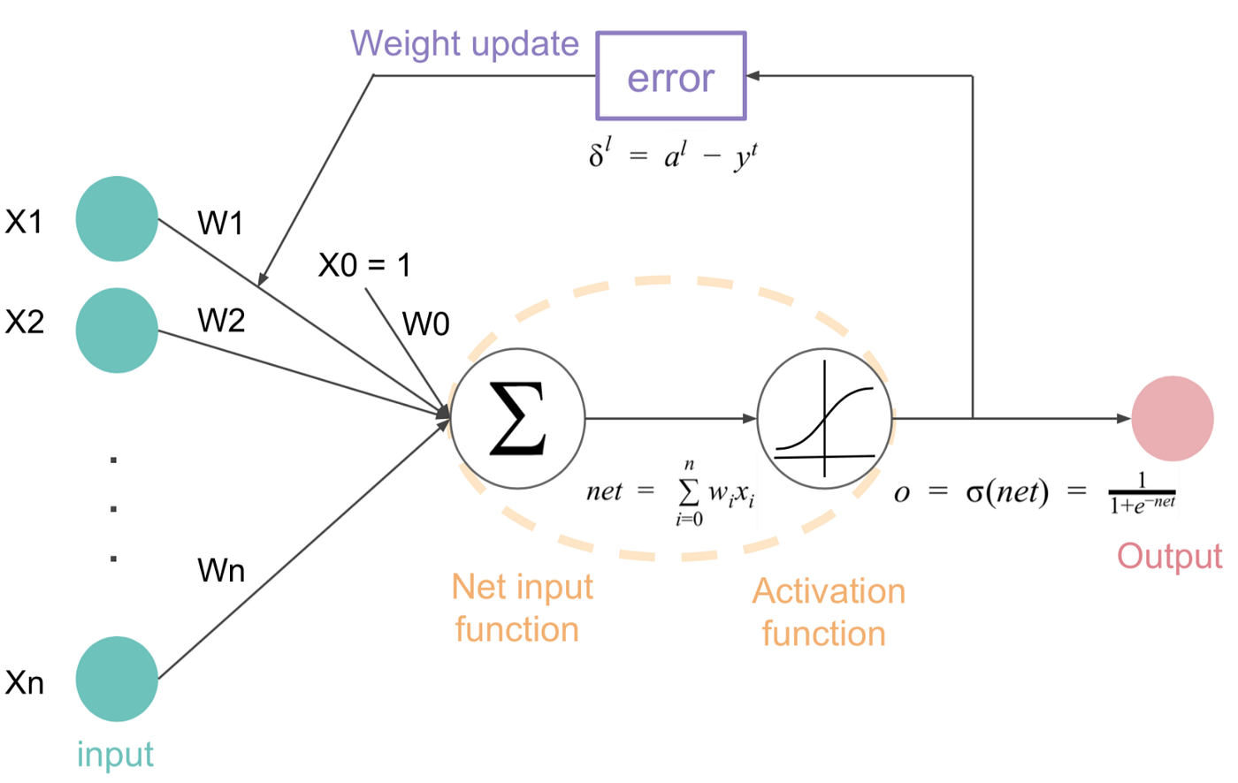

Slide 12
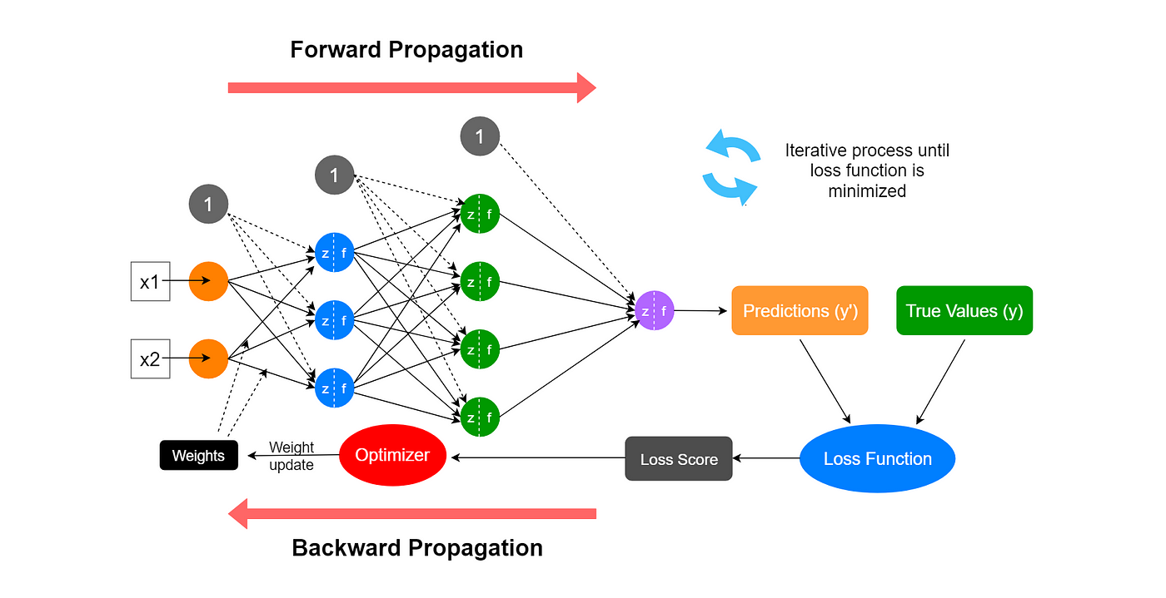

Slide 13
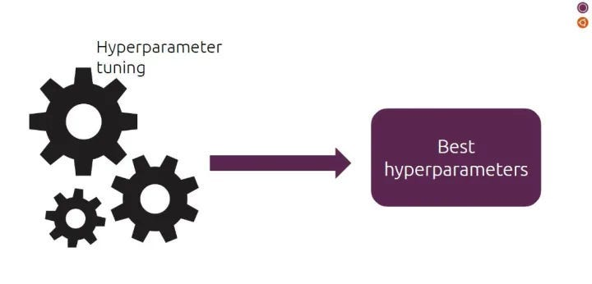
Hyperparameters in Deep Learning
Number of Hidden Layers and Neurons
Activation Functions
Optimizer
Batch Size
Learning Rate
Number of Epochs
Weight Initialization
Dropout Rate – prevent overfitting
Early Stopping Criteria – prevent overfitting
Notes:
https://python.plainenglish.io/deep-learning-made-easy-part-4-hyperparameter-tuning-callbacks-and-regularization-in-anns-75c5b2524cc2

Slide 14
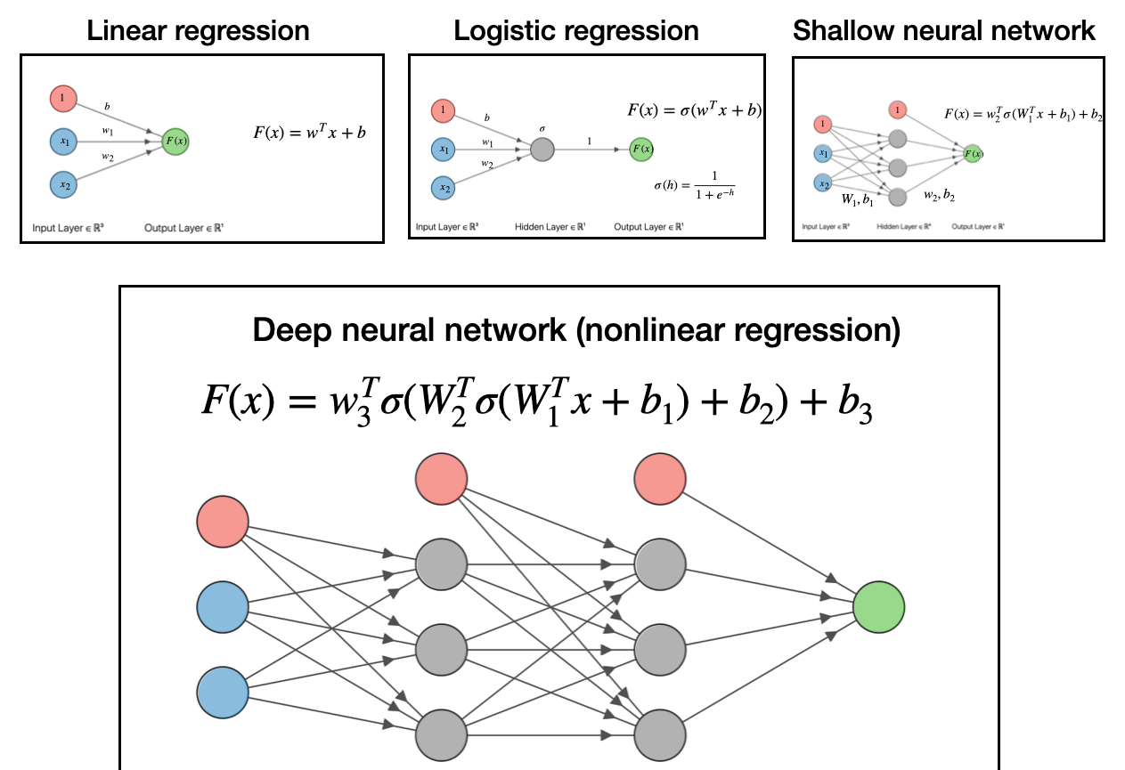
Deep Learning vs Regression

Slide 15

Tensorflow Playground

Slide 16
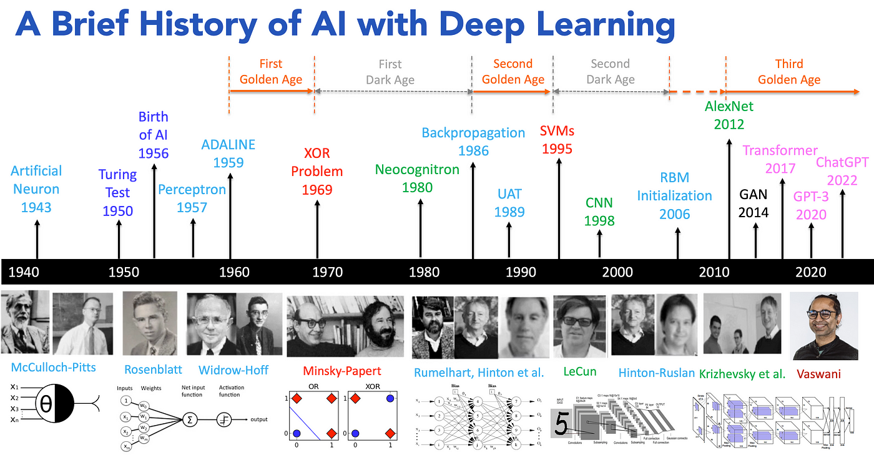
Notes:
https://medium.com/@lmpo/a-brief-history-of-ai-with-deep-learning-26f7948bc87b

Slide 17
Types of Neural Networks Based on Tasks
Perceptrons
Feedforward Neural Networks
Convolutional Neural Networks
Recurrent Neural Networks (RNNs)
Generative Adversarial Network (GAN)
Transformer Architecture

Slide 18
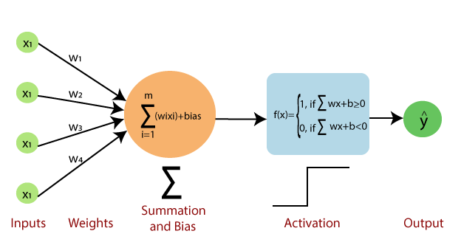
Perceptron

Slide 19
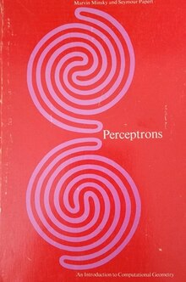
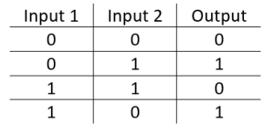

Slide 20
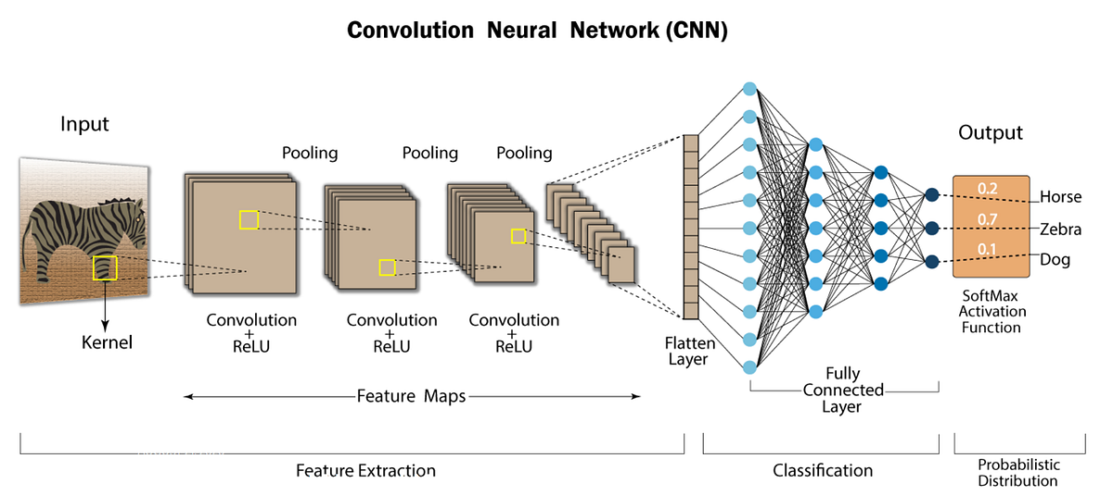
Notes:
https://stanford.edu/~shervine/teaching/cs-230/cheatsheet-convolutional-neural-networks

Slide 21
Pre-Transformer NLP and Mainstream
Word Embeddings
GloVe (Pennington et al., 2014)
Recurrent Neural Networks (RNNs)
Long Short-Term Memory (LSTM)
Gated Recurrent Units (GRUs)
FastText (Bojanowski et al., 2016)
Word2Vec (Mikolov et al., 2013)
Skip-gram: Predicts surrounding words given a target word.
CBOW (Continuous Bag of Words): Predicts the target word given surrounding words.

Slide 22

Why Word Embeddings?
Natural Human Language
Synonyms
Paraphrasing
Analogies
Polysemy
Word embeddings aim to represent text in a way that maintains patterns of thought and reasoning in text data
Connections in meanings

Slide 23

“You shall know a word by the company it keeps!” John Rupert Firth

Slide 24
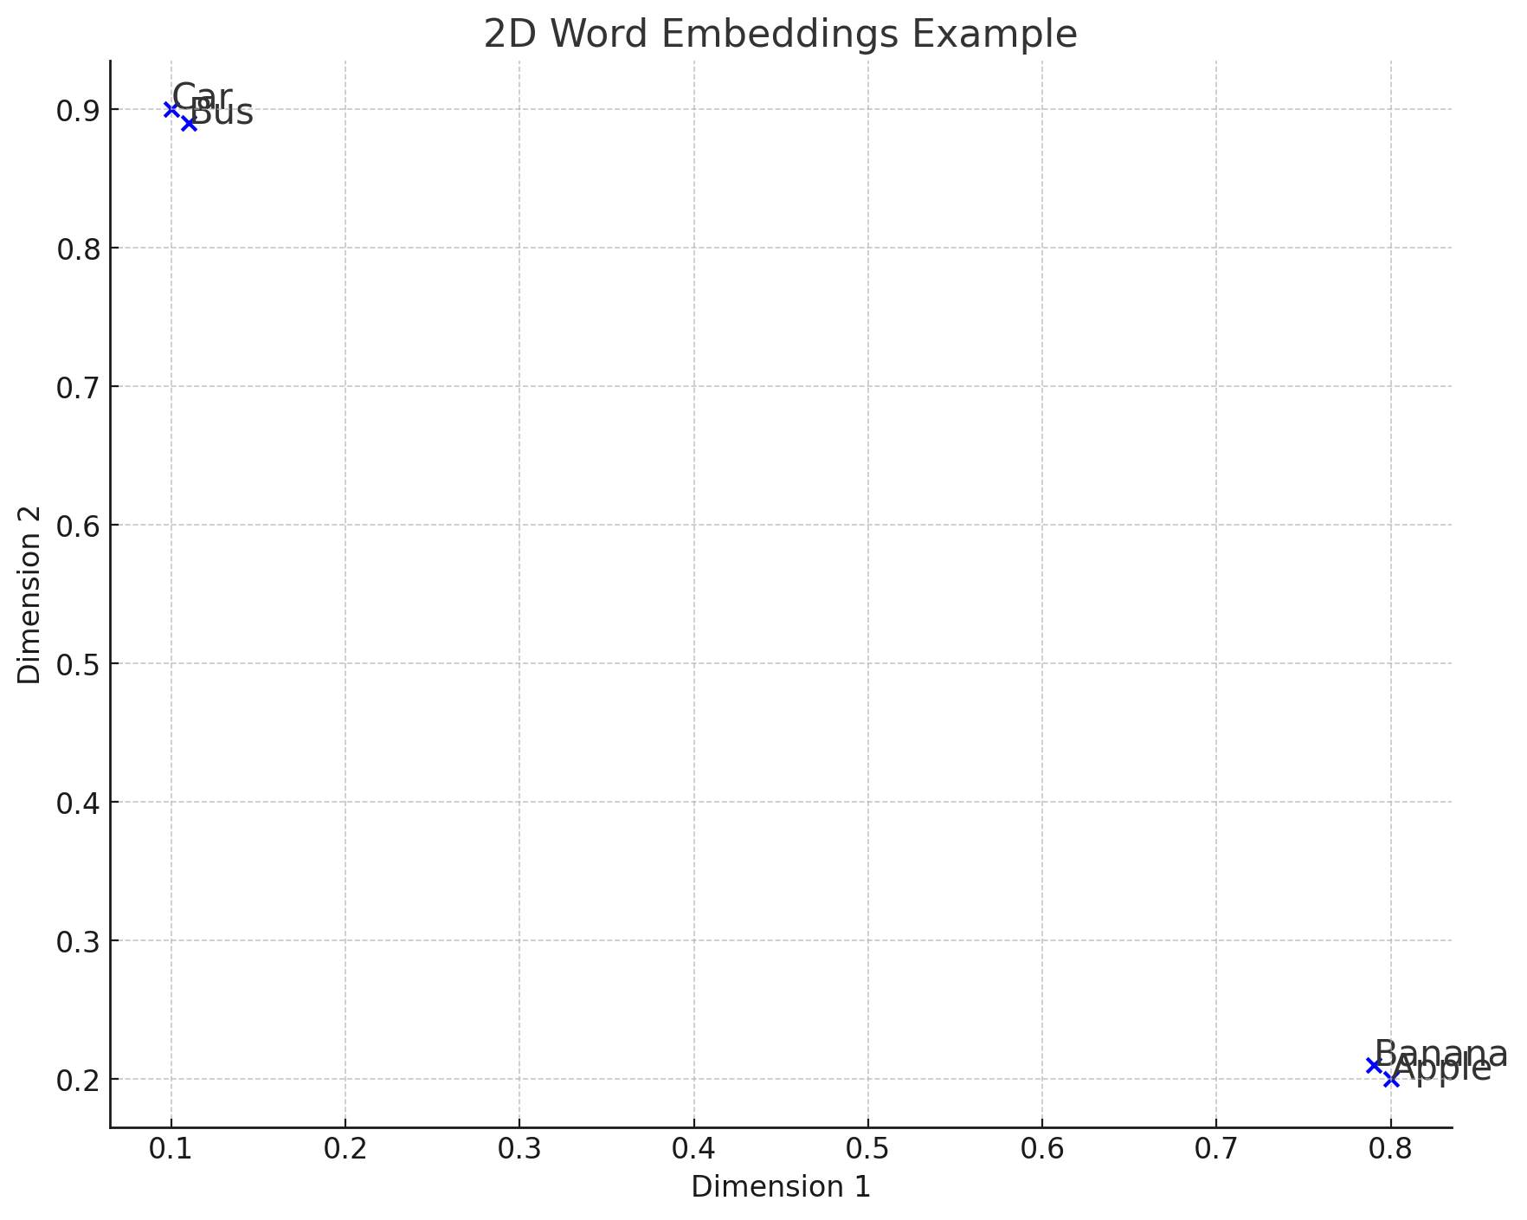
Embedding Words into Vector Spaces
Context Over Counts: Assess contexts in which words co-occur, beyond frequency.
Vector Space Embedding: Utilize patterns of co-occurrence to map each word into an N-dimensional vector space, effectively "embedding" terms into this space.
Visual Analogy: If visualized in two dimensions, this embedding is similar to plotting locations on a map using latitude and longitude.
Example: Like measuring the distance from Phoenix to Flagstaff, we can quantify the "distance" between any two words in this space, revealing their relationship.
Insight: Closer "distances" between words (e.g., Phoenix is closer to Flagstaff than Portland) signify stronger contextual relationships or similarities.
Word Embedding Example
"Apple" embedded as [0.8, 0.2]
"Banana" embedded as [0.79, 0.21]
"Car" might be embedded as [0.1, 0.9]
"Bus" might be embedded as [0.11, 0.89]

Slide 25
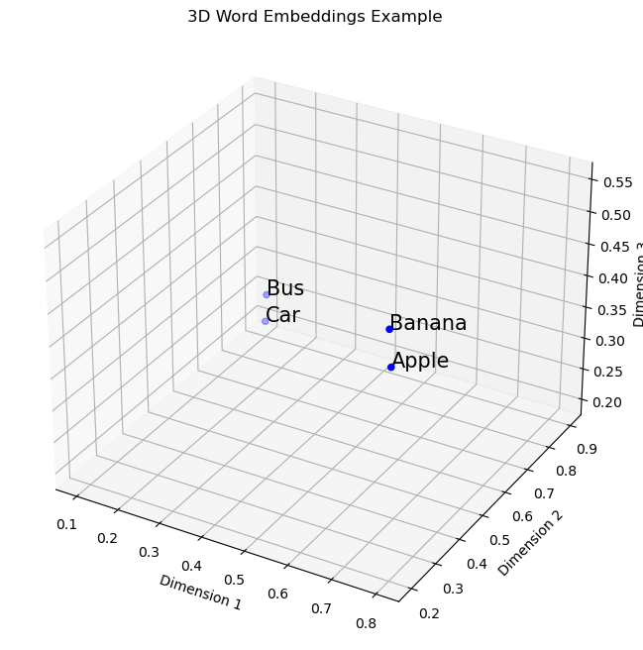
Embedding Words into Vector Spaces: 3D
"Apple": [0.8, 0.2, 0.5],
"Banana": [0.79, 0.21, 0.55],
"Car": [0.1, 0.9, 0.2],
"Bus": [0.11, 0.89, 0.25]

Slide 26
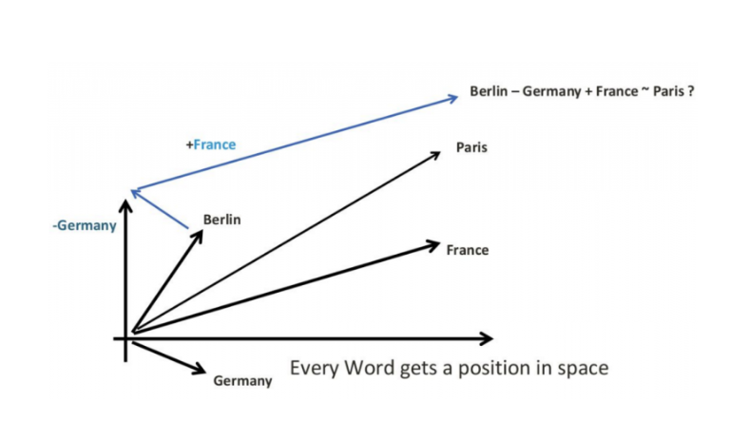
Arithmetic on Embeddings to Derive meaning
Arbitrary 2D vectors:
Berlin: [2, 1]
Germany: [2, 2]
France: [0, 1]
Compute Paris:
Start with Berlin: [2, 1]
Subtract Germany: [2, 1] - [2, 2] = [0, -1]
Add France: [0, -1] + [0, 1] = [0, 0]

Slide 27
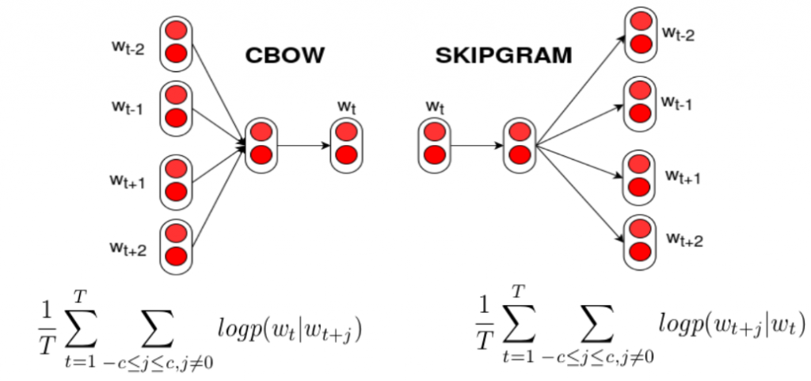
Popular Word Embeddings Models: Word2Vec and Glove

Slide 28
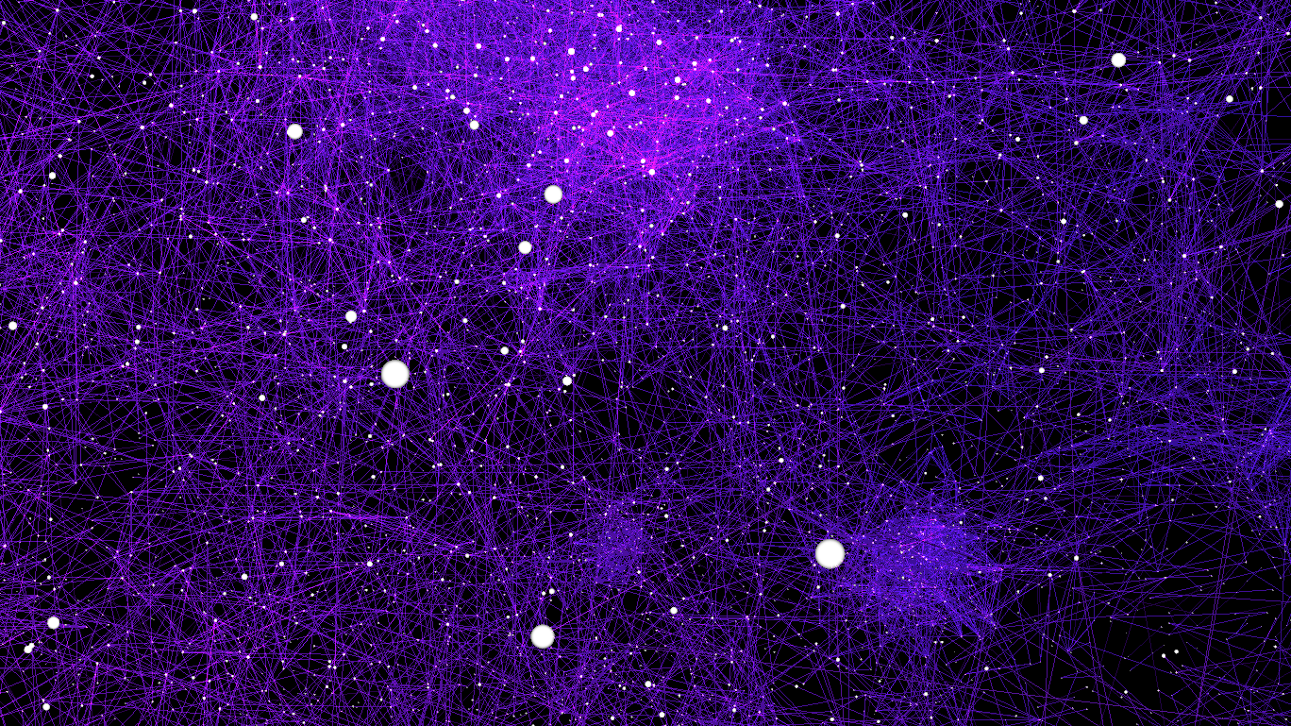
Popular Word Embeddings Models: Word2Vec and GloVe

Slide 29
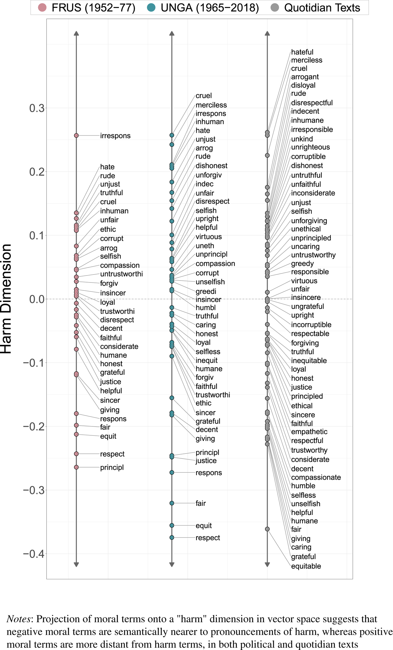
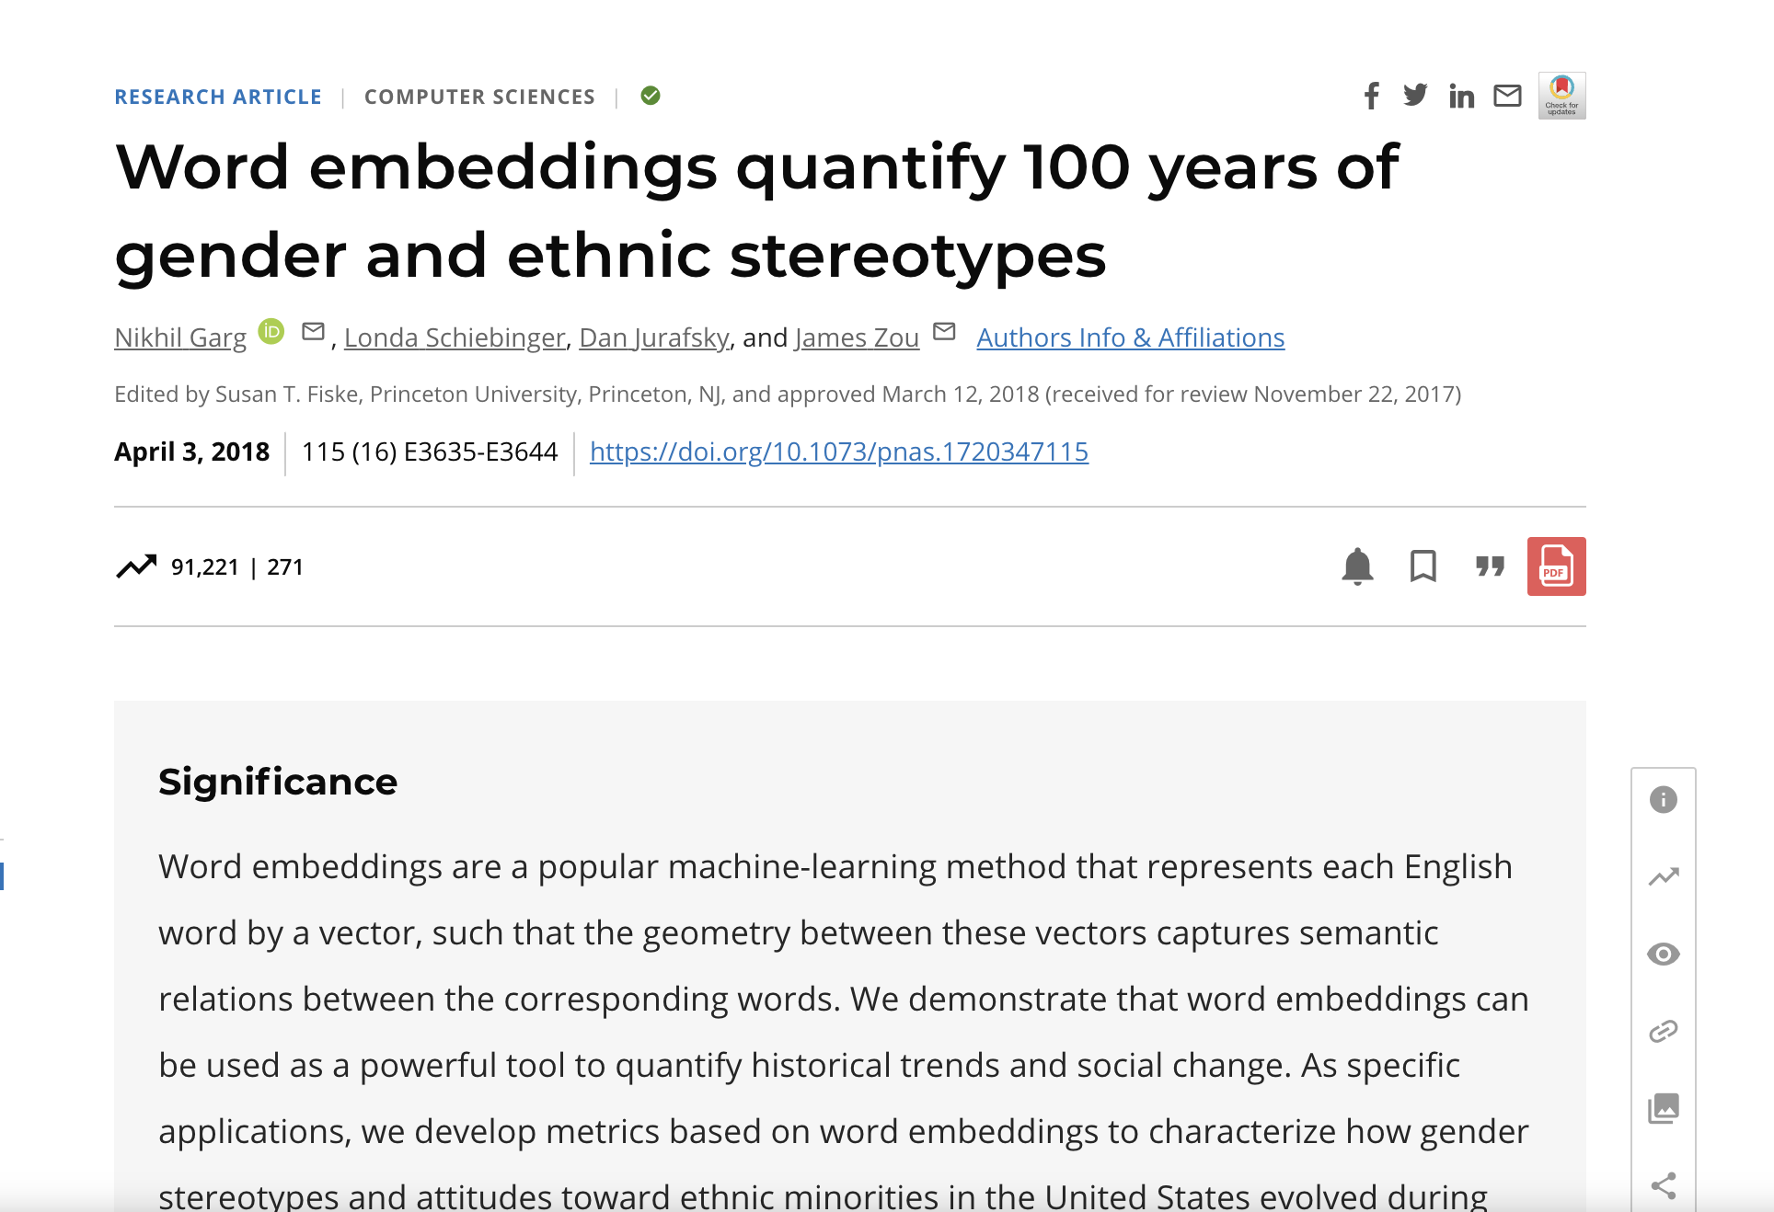
Research Using Word Embeddings

Slide 30
Recurrent Neural Network (RNN)
Neural network designed for sequential data
model dependencies in sequential data
Natural Language Processing (NLP)
time series forecasting
Limitations
Vanishing gradient
Exploding gradient
Lack of parallelization
Key Areas

Slide 31

Recurrent Neural Networks(RNNs)

Slide 32
Key Limitations of RNNs That Led Transformers
Vanishing and Exploding Gradient Problems
Difficulty in Parallelization
Long-Term Dependencies
“The cat that the dog chased was black.”
“the” ➔ “cat” : short-term dependencies
“cat” ➔ “was black”: long-term dependencies

